Slide 1
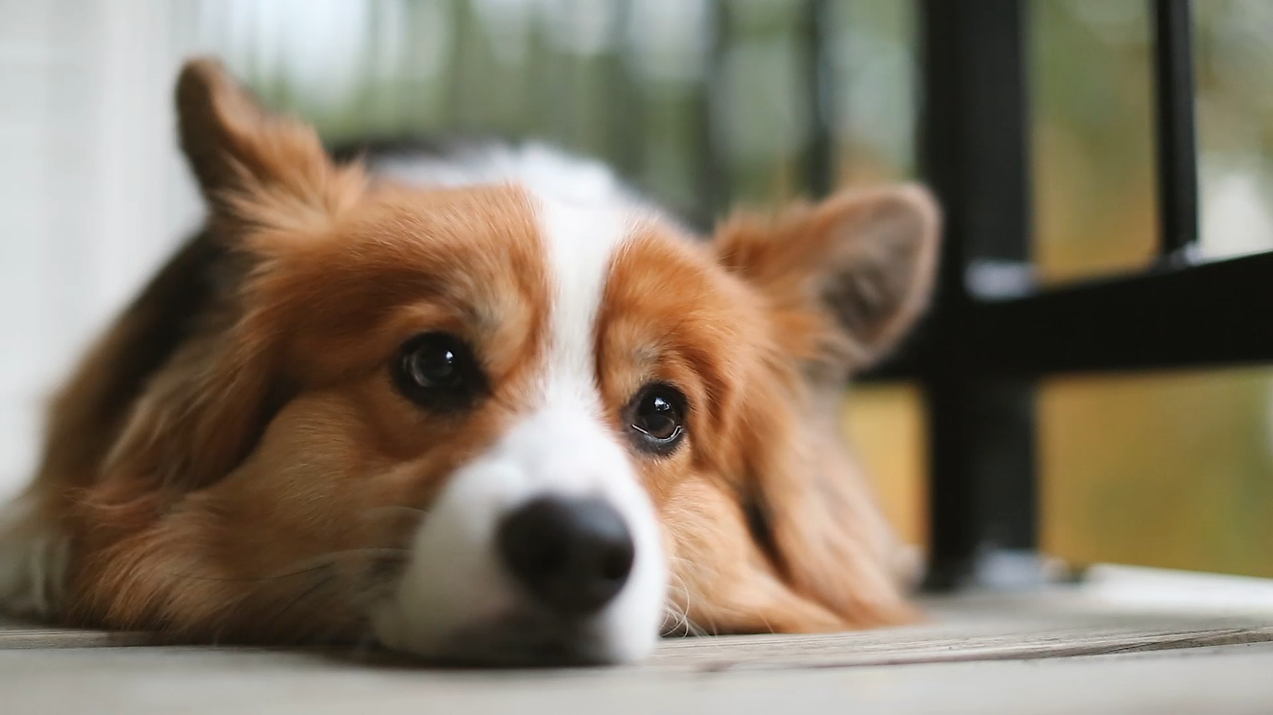
UselessWeb - Animal of the Day
A fun interactive web app for random animal images & sounds.

Slide 2
Contributors
Developer: Sumit Singh
UI Designer: Open- Source Resources
APIs Used: Some-Random-API (Animal APIs)
Sound Effects: Open- Source WAV files converted to MP3s

Slide 3
Technical Barriers & Challenges
1. CORS issues with APIs:
Problem: Some APIs blocked direct requests due to CORS restrictions.
Solution: Used fetch requests with proper headers or switched to APIs, allowing cross-origin requests.
2. API response structure inconsistencies:
Problem: Different APIs return images under different keys ('image', 'link', 'file').
Solution: Checked multiple possible response formats to extract correct image URLs.
3. Handling broken image links: Problem: Some images failed to load due to missing or incorrect URLs.
Solution: Added an 'on error' event to retry fetching another image when an image fails.
4. Ensuring a seamless UI experience.

Slide 4
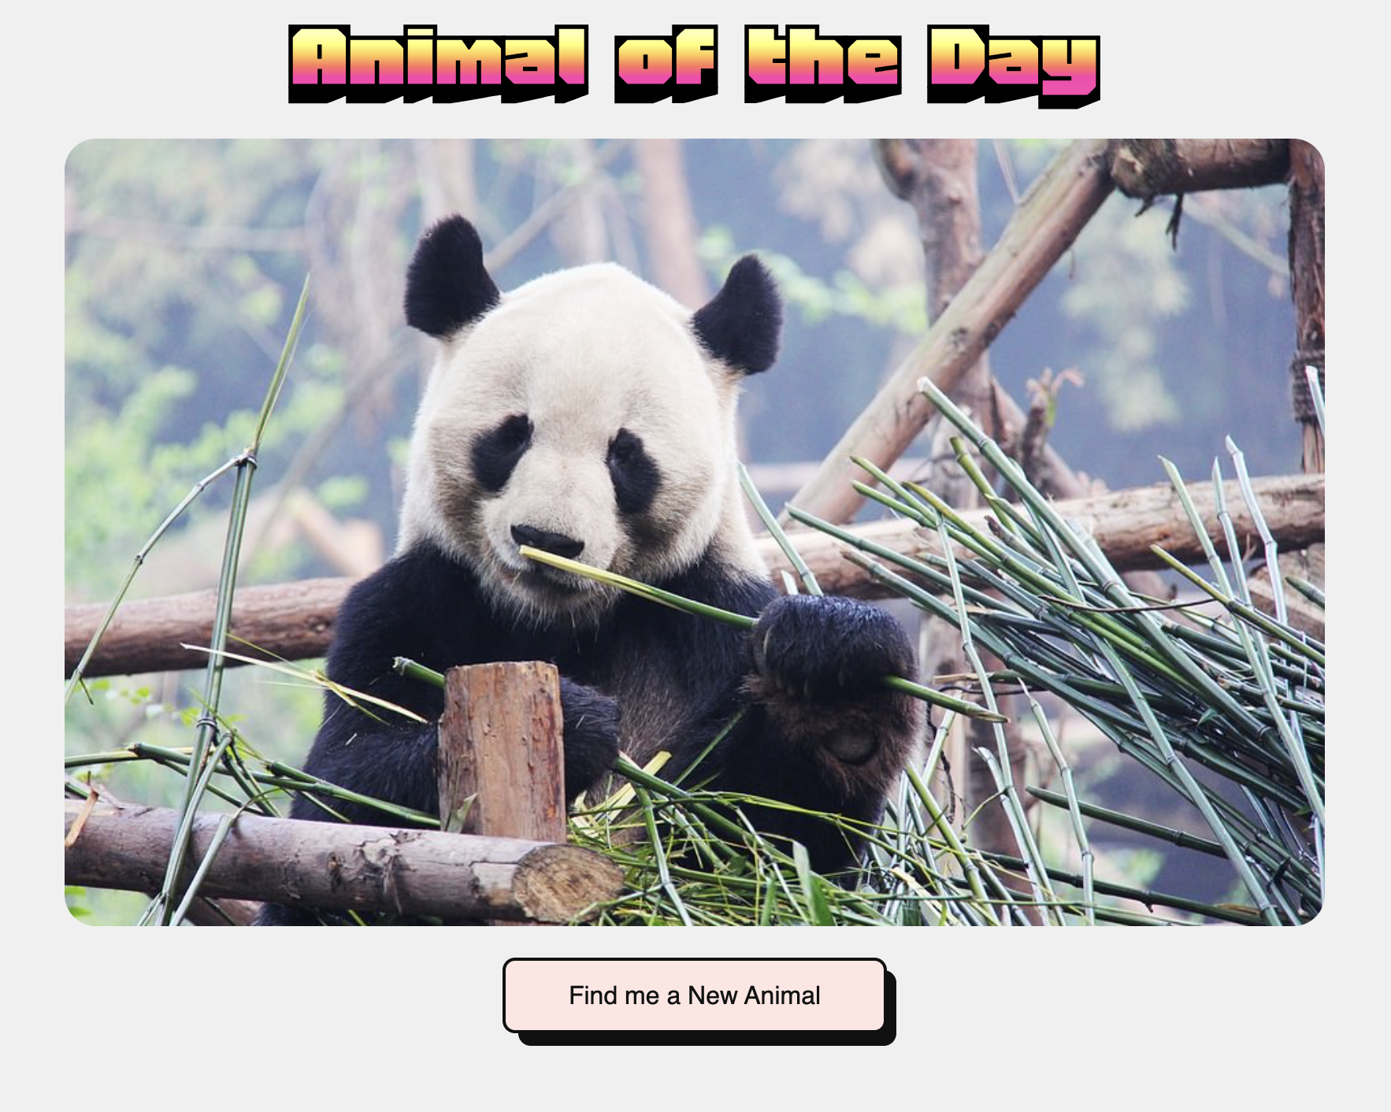
Mockups

Slide 5

Project Demo
Thank You!

